Slide 2

Importing Tkinter:
The code begins by importing the tkinter library with the alias tk. Tkinter is the standard GUI (Graphical User Interface) library for Python and allows us to create windows, widgets, and more.

Slide 3
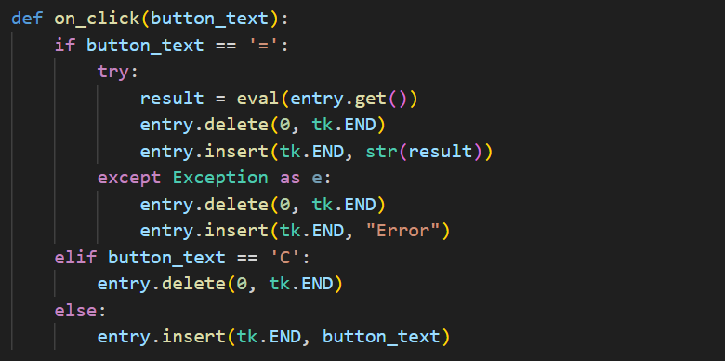
on_click Function
The on_click function is called when a button on the calculator is clicked. It takes the button_text as an argument, representing the text on the button, and performs different actions based on the button clicked.

Slide 4

Creating the Main Application Window
The code creates the main application window using tk.Tk(), and sets its title as "Calculator."

Slide 5
Entry Widget for Displaying Result:
An entry widget is created to display the calculation results. It is positioned at row 0 and spans across all four columns.

Slide 6
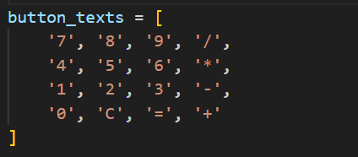
List of Buttons:
A list named button_texts is created, containing the text labels for each button to be displayed on the calculator.

Slide 7
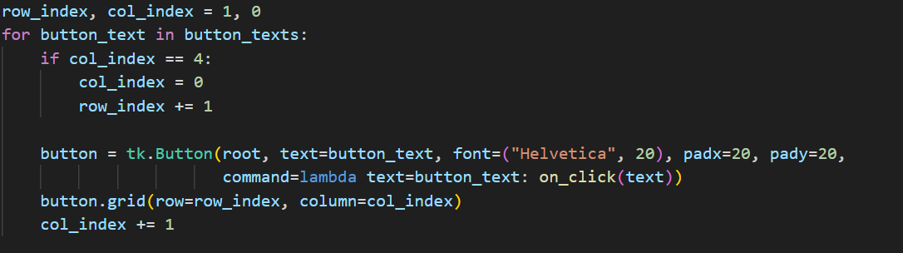
Creating Buttons and Placing Them on the Grid:
The code uses a loop to create buttons from the button_texts list and places them on a 4x4 grid.
Button Click Event Binding: The buttons are associated with the on_click function using the command parameter. When a button is clicked, the corresponding function is executed.

Slide 8

Starting the Main Event Loop:
Finally, the code starts the main event loop using root.mainloop(), which keeps the application running and responsive to user interactions.

Slide 9
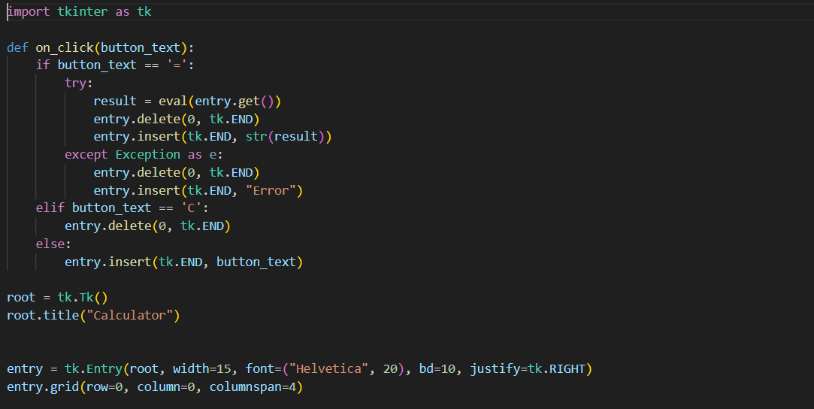
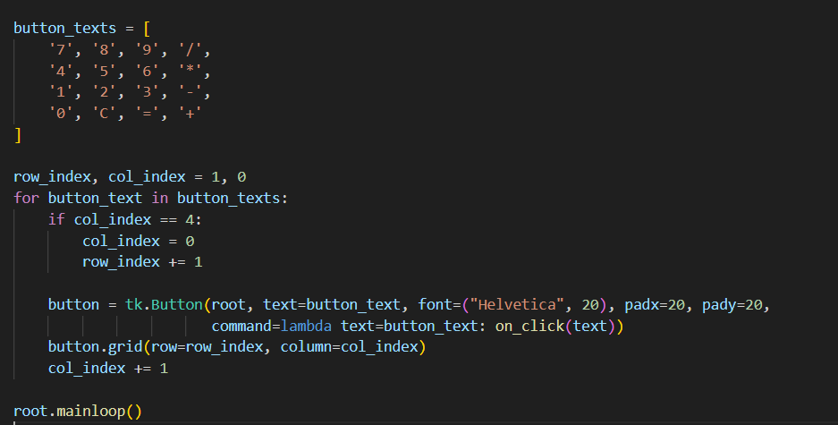
Complete Code :-

Slide 10
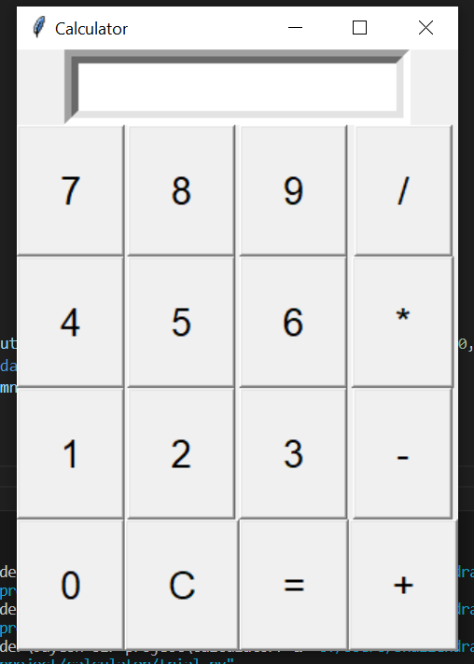
Output :-

Slide 11
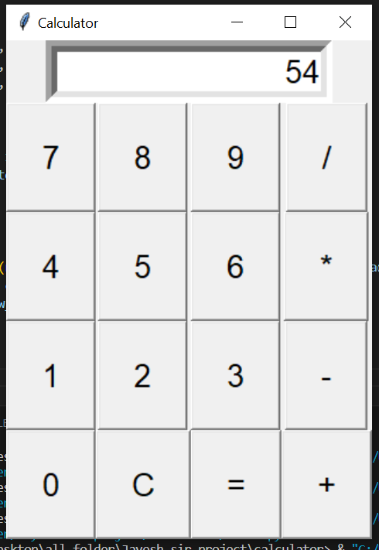
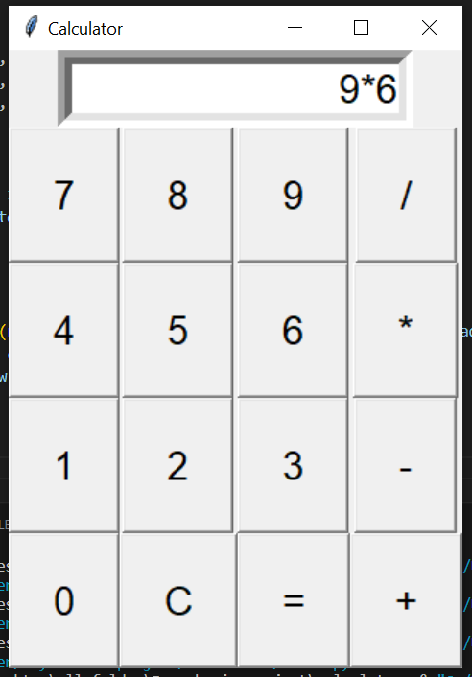
Output after using the function :-

